Slide 1

Lecture 4
Network Layer:
Logical Addressing
19.<number>
Copyright © The McGraw-Hill Companies, Inc. Permission required for reproduction or display.

Slide 2
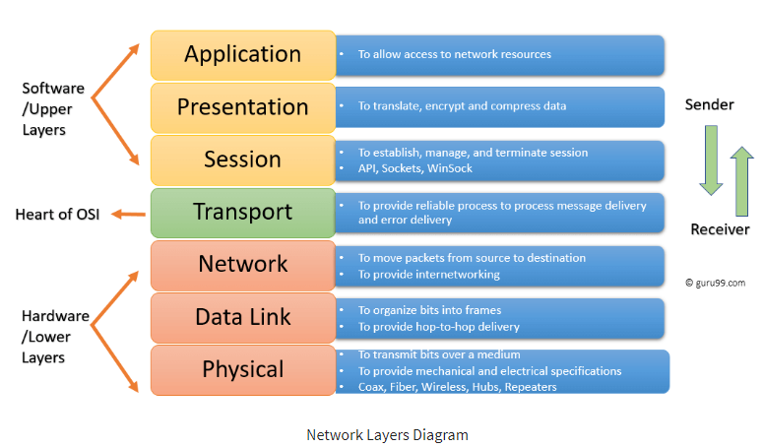
19.<number>

Slide 3

Part 4: Network Layer
Objectives
The network layer is responsible for the source-to-destination delivery of a packet, possibly across multiple networks (links). Whereas the data link layer oversees the delivery of the packet between two systems on the same network (links), the network layer ensures that each packet gets from its point of origin to its final destination.
19.<number>

Slide 4
The network layer adds a header that includes the logical addresses of the sender and receiver to the packet corning from the upper layer. If a packet travels through the Internet, we need this addressing system to help distinguish the source and destination. When independent networks or links are connected together to create an internetwork, routers or switches route packets to their final destination.
19.<number>

Slide 5
19-1 IPv4 ADDRESSES
An IPv4 address is a 32-bit address that uniquely and universally defines the connection of a device (for example, a computer or a router) to the Internet.
19.<number>

Slide 6

Note
An IPv4 address is 32 bits long.
19.<number>

Slide 7
Note
The IPv4 addresses are unique
and universal.
19.<number>

Slide 8
IPv4 addresses are unique: They are unique in the sense that each address defines one, and only one, connection to the Internet. Two devices on the Internet can never have the same address at the same time.
The IPv4 addresses are universal in the sense that the addressing system must be accepted by any host that wants to be connected to the Internet.
19.<number>

Slide 9
Address Space
A protocol such as IPv4 that defines addresses has an address space. An address space is the total number of addresses used by the protocol. If a protocol uses N bits to define an address, the address space is 2^N because each bit can have two different values (0 or 1) and N bits can have 2N values.
IPv4 uses 32-bit addresses, which means that the address space is 232 or 4,294,967,296 (more than 4 billion). This means that, theoretically, if there were no restrictions, more than 4 billion devices could be connected to the Internet.
We will see shortly that the actual number is much less because of the restrictions imposed on the addresses.
19.<number>

Slide 10
Note
The address space of IPv4 is
2³² or 4,294,967,296.
19.<number>

Slide 11

Figure 19.1 Dotted-decimal notation and binary notation for an IPv4 address
19.<number>

Slide 12


Example 19.1
Change the following IPv4 addresses from binary notation to dotted-decimal notation.
Solution
We replace each group of 8 bits with its equivalent decimal number (see Appendix B) and add dots for separation.
19.<number>

Slide 13


Example 19.2
Change the following IPv4 addresses from dotted-decimal notation to binary notation.
Solution
We replace each decimal number with its binary equivalent (see Appendix B).
19.<number>

Slide 14

Example 19.3
Find the error, if any, in the following IPv4 addresses.
Solution
a. There must be no leading zero (045).
b. There can be no more than four numbers.
c. Each number needs to be less than or equal to 255.
d. A mixture of binary notation and dotted-decimal
notation is not allowed.
19.<number>

Slide 15
Note
In classful addressing, the address space is divided into five classes:
A, B, C, D, and E.
19.<number>

Slide 16

Figure 19.2 Finding the classes in binary and dotted-decimal notation
19.<number>

Slide 17
Example 19.4
Find the class of each address.
a. 00000001 00001011 00001011 11101111
b. 11000001 10000011 00011011 11111111
c. 14.23.120.8
d. 252.5.15.111
Solution
a. The first bit is 0. This is a class A address.
b. The first 2 bits are 1; the third bit is 0. This is a class C
address.
c. The first byte is 14; the class is A.
d. The first byte is 252; the class is E.
19.<number>

Slide 18

Classes and Blocks
One problem with classful addressing is that each class is divided into a fixed number of blocks with each block having a fixed size as shown in Table 19.1.
Table 19.1 Number of blocks and block size in classful IPv4 addressing
19.<number>

Slide 19
Previously, when an organization requested a block of addresses, it was granted one in class A, B, or C. Class A addresses were designed for large organizations with a large number of attached hosts or routers. Class B addresses were designed for midsize organizations with tens of thousands of attached hosts or routers. Class C addresses were designed for small organizations with a small number of attached hosts or routers.
We can see the flaw in this design. A block in class A address is too large for almost any organization. This means most of the addresses in class A were wasted and were not used. A block in class B is also very large, probably too large for many of the organizations that received a class B block. A block in class C is probably too small for many organizations. Class D addresses were designed for multicasting as we will see in a later chapter. Each address in this class is used to define one group of hosts on the Internet. The Internet authorities wrongly predicted a need for 268,435,456 groups. This never happened and many addresses were wasted here too. And lastly, the class E addresses were reserved for future use; only a few were used, resulting in another waste of addresses.
19.<number>

Slide 20
Note
In classful addressing, a large part of the available addresses were wasted.
19.<number>

Slide 21
Netid and Hostid
In classful addressing, an IP address in class A, B, or C is divided into netid and hostid.
Note that the concept does not apply to classes D and E.
In class A, one byte defines the netid and three bytes define the hostid. In class B, two bytes define the netid and two bytes define the hostid. In class C, three bytes define the netid and one byte defines the hostid.
Mask
Although the length of the netid and hostid (in bits) is predetermined in classful addressing, we can also use a mask (also called the default mask), a 32-bit number made of contiguous 1’s followed by 0’s. The masks for classes A, B, and C are shown in Table 19.2.
The concept does not apply to classes D and E.
19.<number>

Slide 22

Table 19.2 Default masks for classful addressing
19.<number>

Slide 23
The last column of Table 19.2 shows the mask in the form In where n can be 8, 16, or 24 in classful addressing. This notation is also called slash notation or Classless Interdomain Routing (CIDR) notation. The notation is used in classless addressing, which we will discuss later. We introduce it here because it can also be applied to classful addressing. We will show later that classful addressing is a special case of classless addressing.
19.<number>

